Slide 1
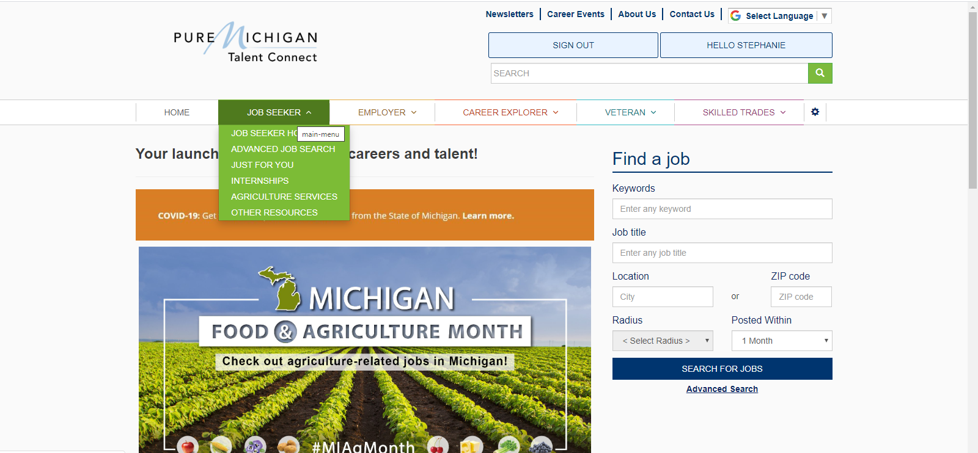
Pure Michigan Talent Connect Job Search

Slide 2
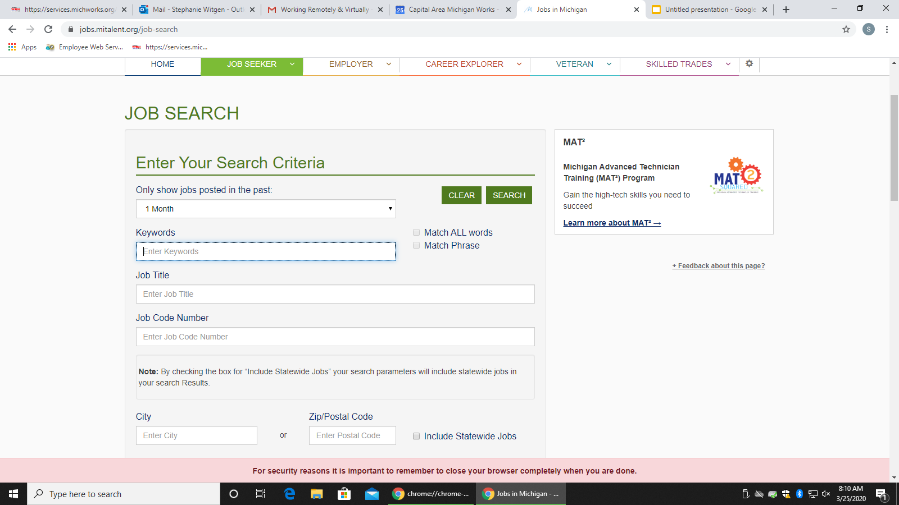
There are many ways to narrow your search

Slide 3
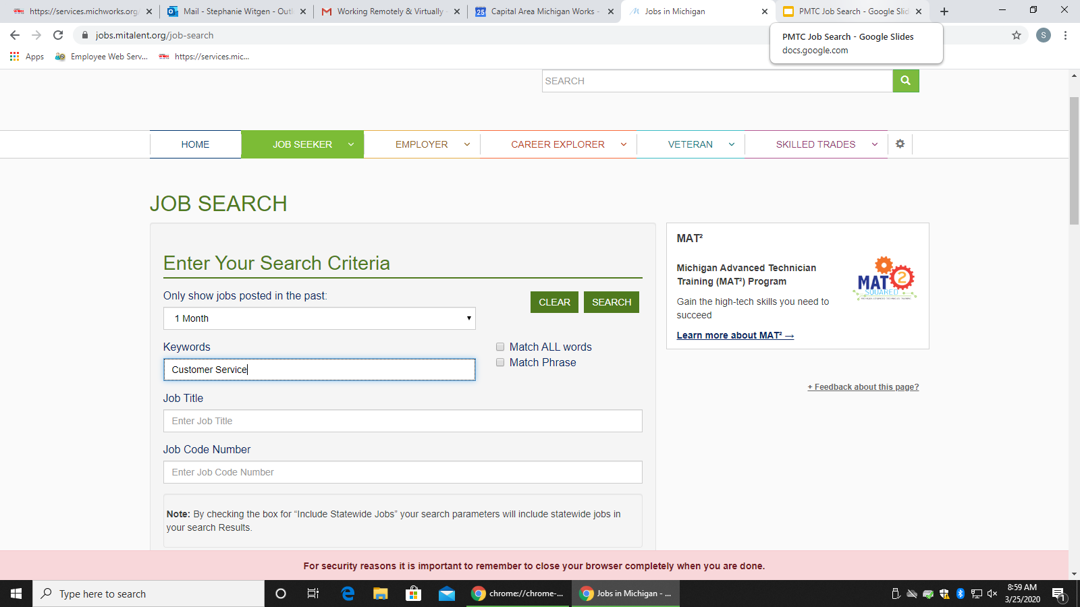
You can use Keywords or Job Title

Slide 4
You can search by City, Zip Codes, State and Mile Radius

Slide 5
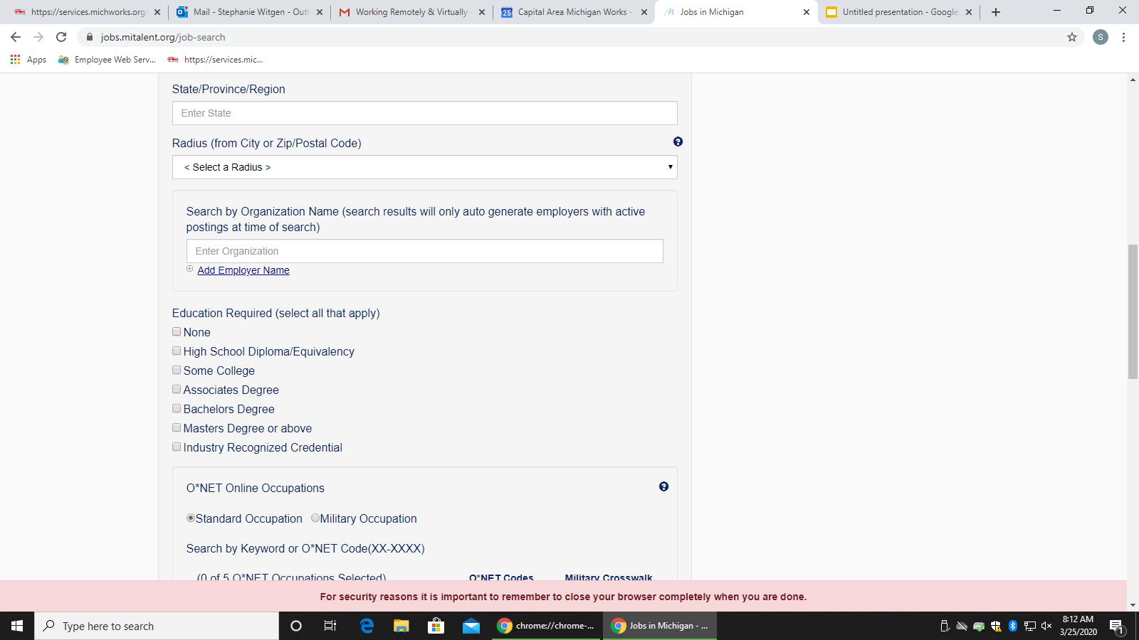
You can narrow your job search with many options

Slide 6
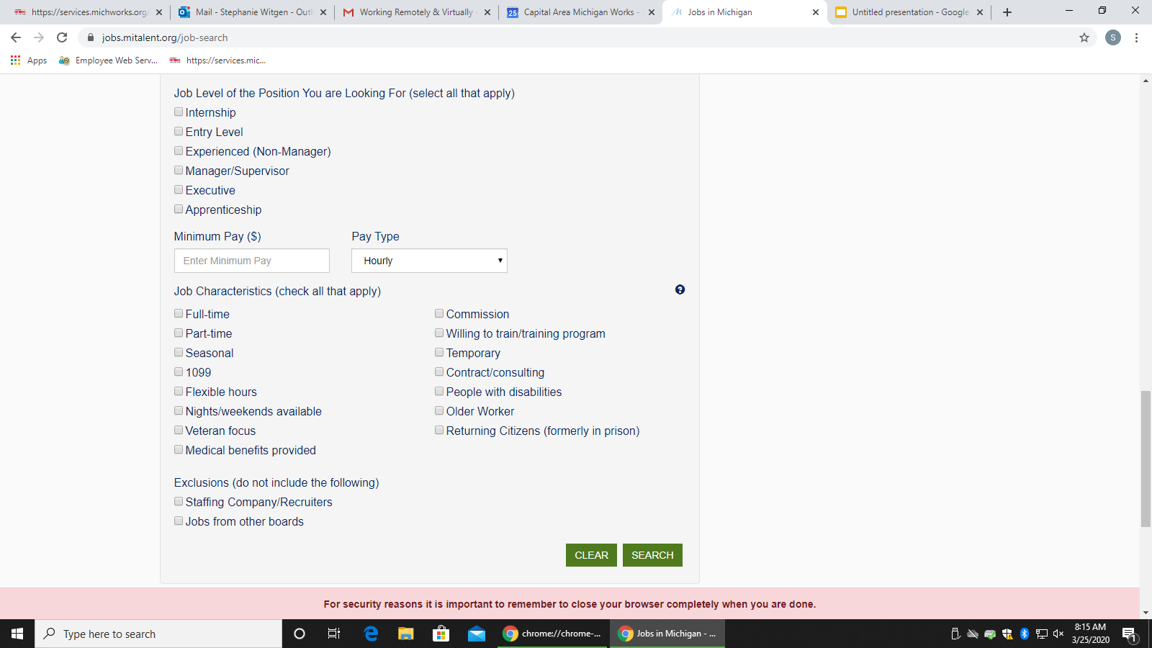
After selecting your search criteria, click “Search”

Slide 7
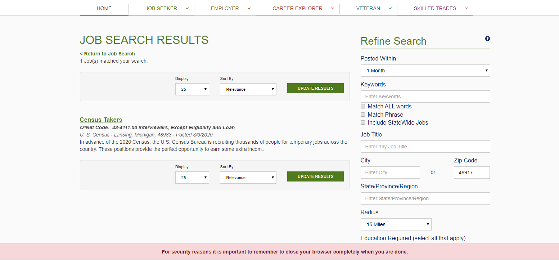
Job Search Results. Click the job title for information about the job.

Slide 8
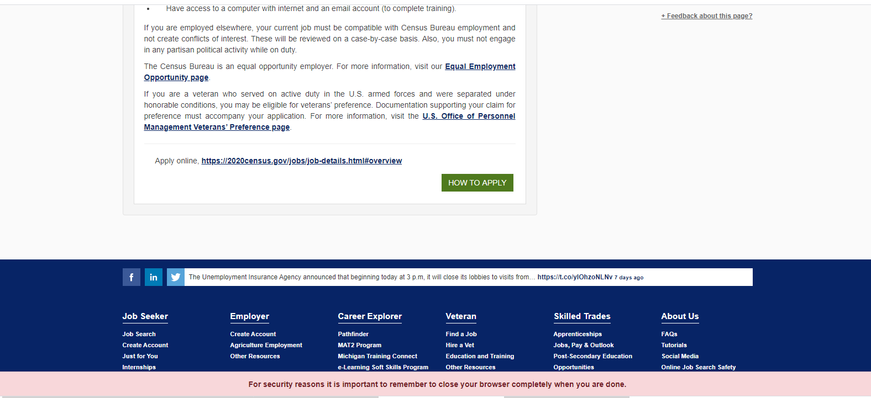
Click “How To Apply” for specific instructions from the employer

Slide 9
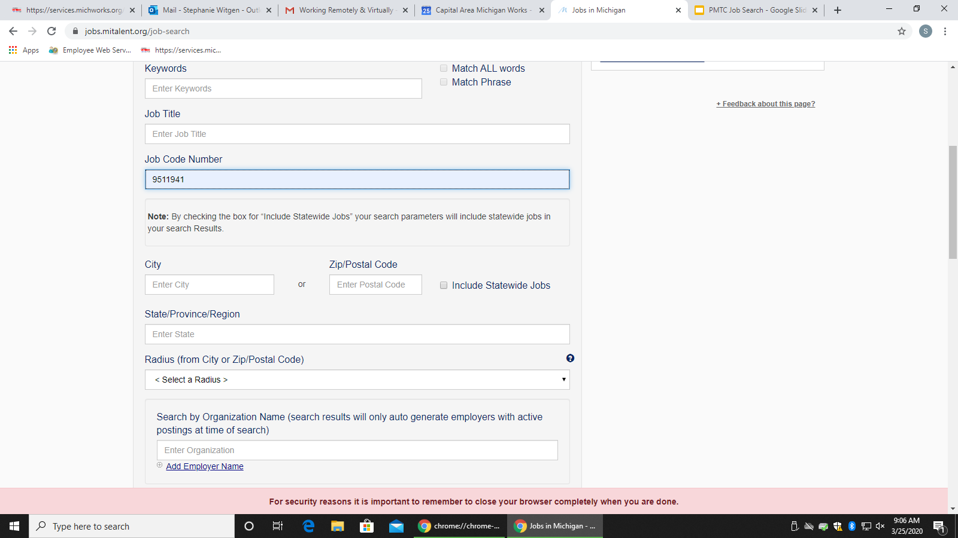
The quickest way to search for jobs from the “Current Openings List” is with the Job Code. (See Slide 10 for an example of Current Openings List and Job Codes)

Slide 10
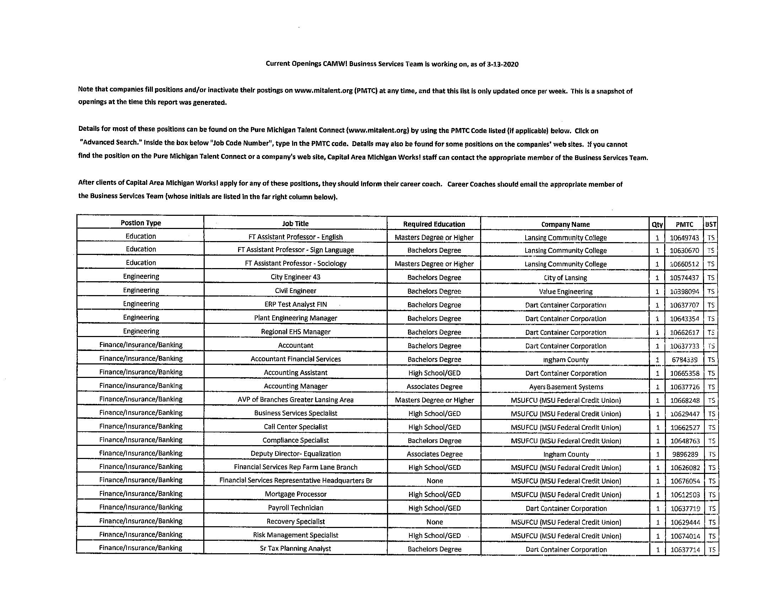
The CAMW! Current Job Openings List created by CAMW! BST corresponds with PMTC.
There, you will find a list of jobs that are also listed on Pure Michigan Talent Connect.
Each job has a corresponding Job Code Number.

